Slide 1
Ecommerce Data Analysis by Using SQL

Slide 2
Table Of Contents
Problem Statement
Our Approach For The Project
Aggregation on Different KPI’s
Dashboard
Insights
Recommendations

Slide 3
Problem-statement
Main aim is to analyze the data of Ecommerce KPI analysis and extract valuable insights that can help us understand the trends of different products, category and brands.
To find out Total Revenue or sale trends generated over the years. .
Also find out meaningful insights that can help improve business operations and decision-making.

Slide 4
Our Approach For The Project
COLLECTION OF ECOMMERCE DATASETS
TO ANALYZE THE DATA BY USING SQL QUERY TO FINOUT PROFIT, PROFIT MARGIN AND TOTAL REVEUNUE
VISUALIZING DATA USING POWER BI

Slide 5
Aggregation on Different KPI’s

Slide 6
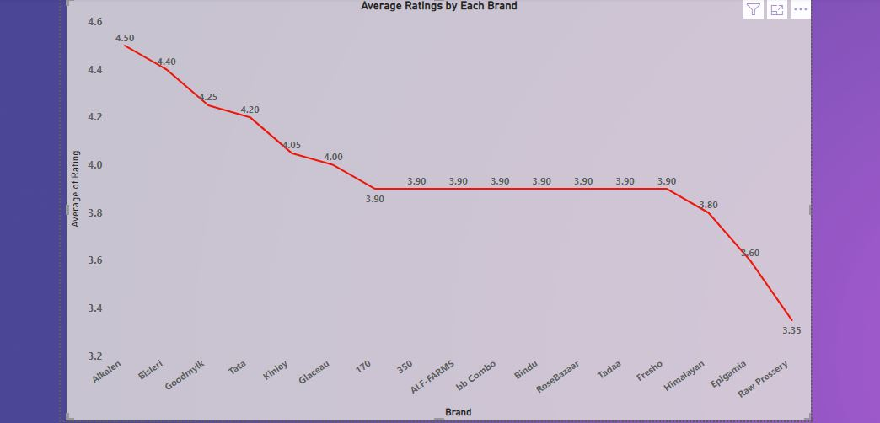
Average Ratings by Each Brand

Slide 7
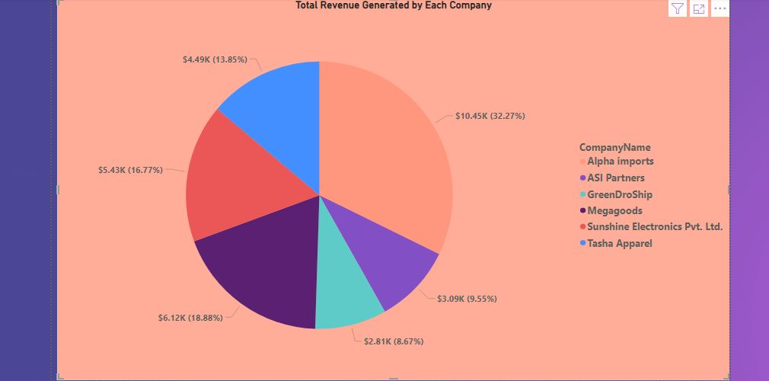
Total Revenue Generated by Each Company

Slide 8
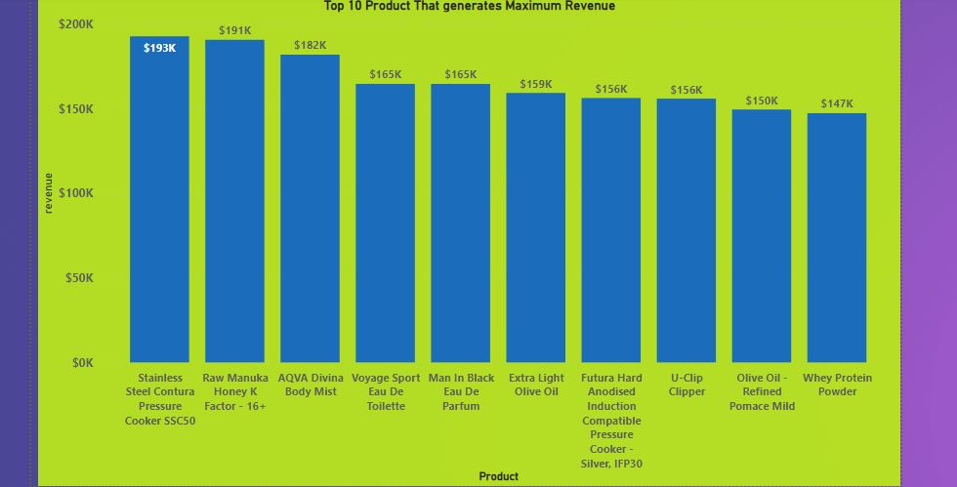
Top 10 Product that Generates Maximum Revenue

Slide 9
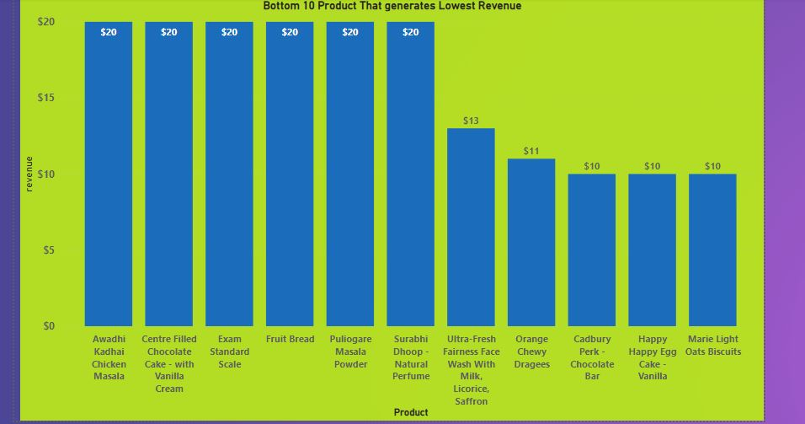
Bottom 10 Product that Generates Maximum Revenue

Slide 10
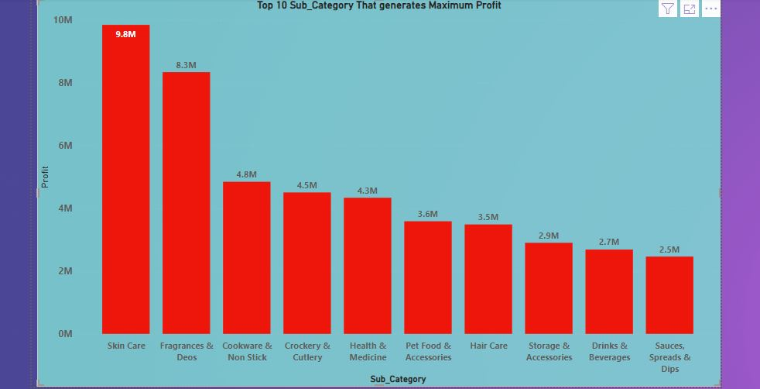
Top 10 Sub_Category that Generates Maximum Revenue

Slide 11
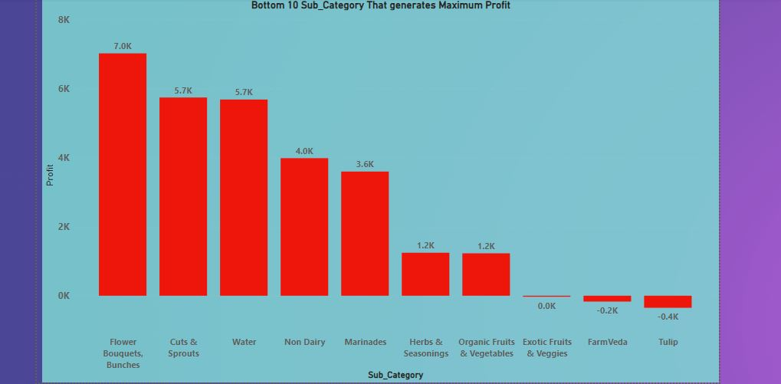
Bottom 10 Sub_Category that Generates Maximum Revenue

Slide 12
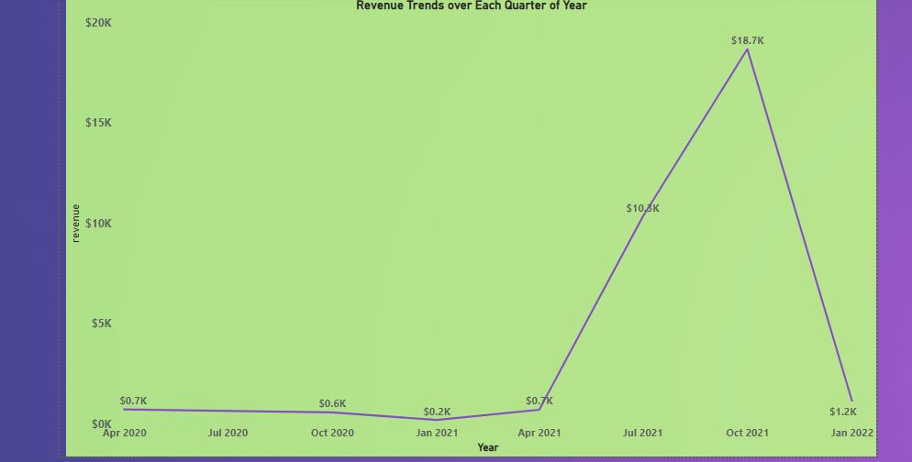
Revenue Trends over Each Quarter of Year

Slide 13
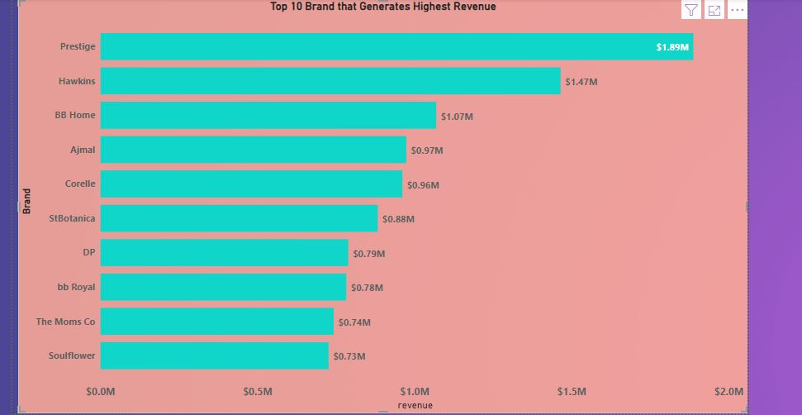
Top 10 Brand that Generates Highest Revenue

Slide 14
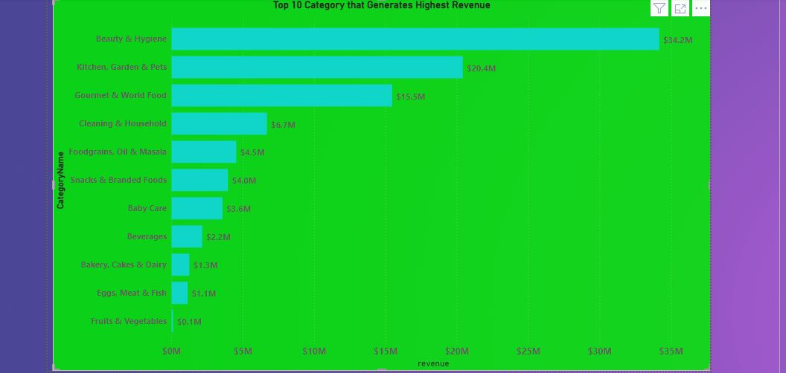
Top 10Category that Generates Highest Revenue

Slide 15
Dashboard

Slide 16
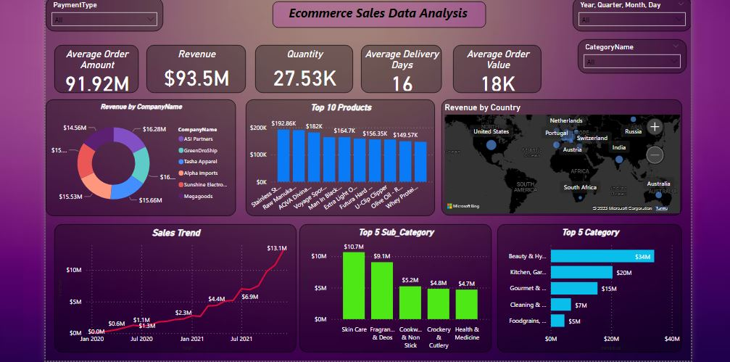

Slide 17
Key Insights
Sales growth in each of the respective quarters of the year is not satisfactory.
Revenue continuously decreases; the company should take precautionary action for that.
The company mainly focuses on its average delivery time for each order.
The retention rate of customers is good.
Alpha Imports generate the highest percentage of revenue, while Tasha Apparel generates the lowest percentage of revenue.
Brands like Prestige generate the highest revenue.
The category Beauty and Hygiene generates the highest revenue.
The brand with the highest average ratings is Alkalen, i.e., 4.50, and the brand with the lowest average ratings is Raw Pressery, i.e., 3.35.
Skin care, Fragrances, and Cookware are the top-selling subcategories by revenue.

Slide 18
Key Insights
Organic, Herbs, and Marinade are the least selling subcategories by revenue.
Beauty & Hygiene, Kitchen, and World Food are the top-selling categories by revenue.
Fruits & Vegetables, Eggs Meat & Fish, and Bakery are the highest selling categories by revenue.
BB Home, bb Royal, and Fresho are the top-selling brands according to quantity.
Stainless steel Contura pressure cooker products generate the maximum revenue, while Marie Light Oats Biscuits generate the least revenue in terms of product.

Slide 19
Thank You

